Slide 1


Import

Slide 2

“I use databases because its where the
data is.”
rob banks
money
–Willie Sutton

Slide 3
(Applied) Data Science
Visualize
Import
Tidy
Model
Communicate
Transform
Program

Slide 4


Connecting to SQL Server

Slide 5
Connecting to SQL
Click Database
Click Driver Manager
Click New
Put the following settings:
Driver Type: Generic
Driver Name: SQL Server
Class Name: com.microsoft.sqlserver.jdbc.SQLServerDriver
URL Template: jdbc:sqlserver://{host}[:{port}][;databaseName={database}]
Default Port: 1433
Default Database: master
Move to the Libraries tab

Slide 6
Connecting to SQL
On the Libraries Tab
Click Add File
Navigate to C:/Program Files/Dbeaver/plugins
Open mssql-jdbc-12.4.1.jre11.jar
Click Add File again
Navigate to C:/Program Files/Dbeaver/jre/bin
Change the file type selector to *.*
Open mssql-jdbc_auth-12.4.1.x64.dll
Click Ok
Click Database
Click New Database Connection

Slide 7
Connecting to SQL
Select your Generic SQL Server from the All tab
Enter the following properties
Host: DEVSQL17\CountyStat_DW
Port: 50900
Database/Schema: HealthCare_DataWarehouse
Username: Your T#
Password: Your Windows Password
Click Ok
Double Click the new connection from the Database Navigator
The connection should fail
Right click the Connection and select Edit Connection

Slide 8
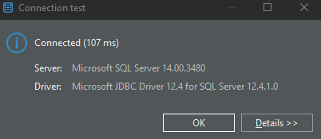
Connecting to SQL
Navigate to the Driver properties Tab
Verify the encrypt property is set to true
Set the integratedSecurity property to true
Set the trustServerCertificate property to true
Click Test Connection
If you get this screen click OK
If not raise your hand

Slide 9
Writing SQL

Slide 10
SQL IDE’S
There are a bunch of SQL IDE’s each database provider has their own
If you’re in a workplace like mine with no standard then I suggest something like DBeaver because it connects to pretty much everything
If not, then use whatever comes standard with the platform

Slide 11
SQL

Slide 12
“SQL is a domain specific language used in programming and … data held in a relational database management system”
–Wikipedia

Slide 13


Structuring a Query

Slide 14
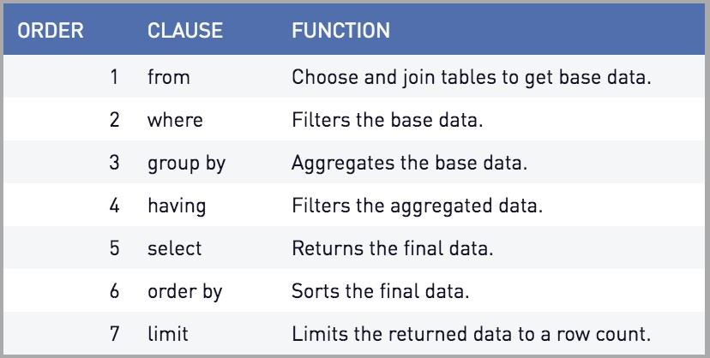
QUERIES
Source: periscope data

Slide 15


EXERCISE
Open Dbeaver
Highlight the Dev Warehouse Connection
Create a new SQL Script
SQL > New SQL Script (or CRTL+])
Build a query that selects Vaccine Site locations from the Health_SalesForce_Site table

Slide 16

SOLUTION
SELECT * FROM ACHD.Health_SalesForce_Site
DBeaver Short Cut:
Right click the table you want to start a query from in the Database Navigator
Click Read data in SQL console
Note: This method names all of the columns instead of using *

Slide 17
WHERE

Slide 18
BETWEEN … AND
BETWEEN
Grab Values between two other values, like IN but for numeric values
Works like < and >
SELECT column_name(s) FROM table_name
WHERE column_name BETWEEN value1 AND value2;

Slide 19
IN STATEMENTS
Useful for when you have an input that returns multiple
This works the same way %in% does in R
Checks to see if the value in the column matches any of the values in your list
SELECT column_name(s) FROM table_name
WHERE column_name IN (value1, value2, ...)

Slide 20

EXERCISE
This time let’s target Health_SalesForce_Appointment
Use the BETWEEN function as a WHERE filter to get Second Dose appointments from April 1st to the 30th in 2021.
Stretch goal: Use the IN Filter to get requests where the status is either "Day Of Screening Question Incomplete" or "Cancelled".

Slide 21
SOLUTION
SELECT * FROM ACHD.Health_SalesForce_Appointment
WHERE Dose_Number__c = 'Second Dose' AND
Appointment_Date_Time__c BETWEEN '2021-04-01' AND '2021-04-30'
SELECT * FROM ACHD.Health_SalesForce_Appointment
WHERE Dose_Number__c = 'Second Dose' AND
Appointment_Date_Time__c BETWEEN '2021-04-01' AND '2021-04-30' AND
Status__c IN ('Cancelled', 'Day Of Screening Question Incomplete')

Slide 22
Pop Quiz
Tidyverse equivalent?
filter()

Slide 23
SELECT Functions and GROUP BY

Slide 24

SQL FUNCTIONS
Sometimes you don’t just want the raw data
‣
‣
You want to aggregate the data in SQL before you load it into R
Use another server to do the heavy lifting so you don’t have to!

Slide 25
DISTINCT
DISTINCT()
Every unique value of a column.
Placing TWO columns inside will return unique instances of both columns:
DISTINCT(“REQUEST_TYPE”, “DEPARTMENT”)

Slide 26
Pop Quiz
Tidyverse equivalent?
distinct()

Slide 27
MATH FUNCTIONS
MIN()
Returns minimum value in a column(s)
MAX()
Return max value in a column(s)

Slide 28
Pop Quiz
Tidyverse equivalent?
min(), max()

Slide 29
COUNT, AVERAGE, SUM
COUNT() - returns the number of rows that your query returns
SELECT COUNT(column_name) FROM table_name
AVG() - returns the average value of a numeric column.
SELECT AVG(column_name) FROM table_name
SUM() - function returns the total sum - numeric columns only
SELECT SUM(column_name) FROM table_name

Slide 30
Pop Quiz
R/Tidyverse equivalents?
n(), mean(), sum()

Slide 31
GROUP BY
This is helpful for when you are doing any of the summary functions mentioned in the previous slides.
(COUNT, SUM, MAX etc)
Any column that isn’t handled with a function should be included in your GROUP BY
SELECT column_name(s), max(column_name) FROM table_name
WHERE condition
GROUP BY column_name(s)

Slide 32
Pop Quiz
Tidyverse equivalent?
group_by()

Slide 33
EXERCISE
This time we will use the Health_SalesForce_Contact table
Count the number of people in each Zip Code
Stretch Goal: Get the number by Zip Code that jave received a Second Dose

Slide 34
SOLUTION
SELECT
[MailingAddress.postalCode], COUNT(Id)
FROM HealthCare_DataWarehouse.ACHD.Health_SalesForce_Contact
GROUP BY [MailingAddress.postalCode]
SELECT
[MailingAddress.postalCode], COUNT(Id)
FROM HealthCare_DataWarehouse.ACHD.Health_SalesForce_Contact
WHERE Second_Dose_Received_Date__c IS NOT NULL
GROUP BY [MailingAddress.postalCode]

Slide 35
Other Functions

Slide 36
CASE
CASE statements are for when you want to return categorical values based off of something else.
SELECT OrderID, Quantity, CASE WHEN Quantity > 30 THEN "The quantity is greater than 30" WHEN Quantity = 30 THEN "The quantity is 30" ELSE "The quantity is under 30" END AS QuantityText FROM OrderDetails;

Slide 37
Pop Quiz
Tidyverse equivalent?
case_when()

Slide 38
CONCAT
CONCAT()
This is mostly used when you have multiple columns you need.
May look different depending on DB server
SELECT CONCAT(column1, " ", column2) AS ConcatenatedString;
OR
SELECT column1|| " “ || column2 AS ConcatenatedString;

Slide 39
Pop Quiz
R equivalent?
paste()/paste0()

Slide 40
JOINS

Slide 41
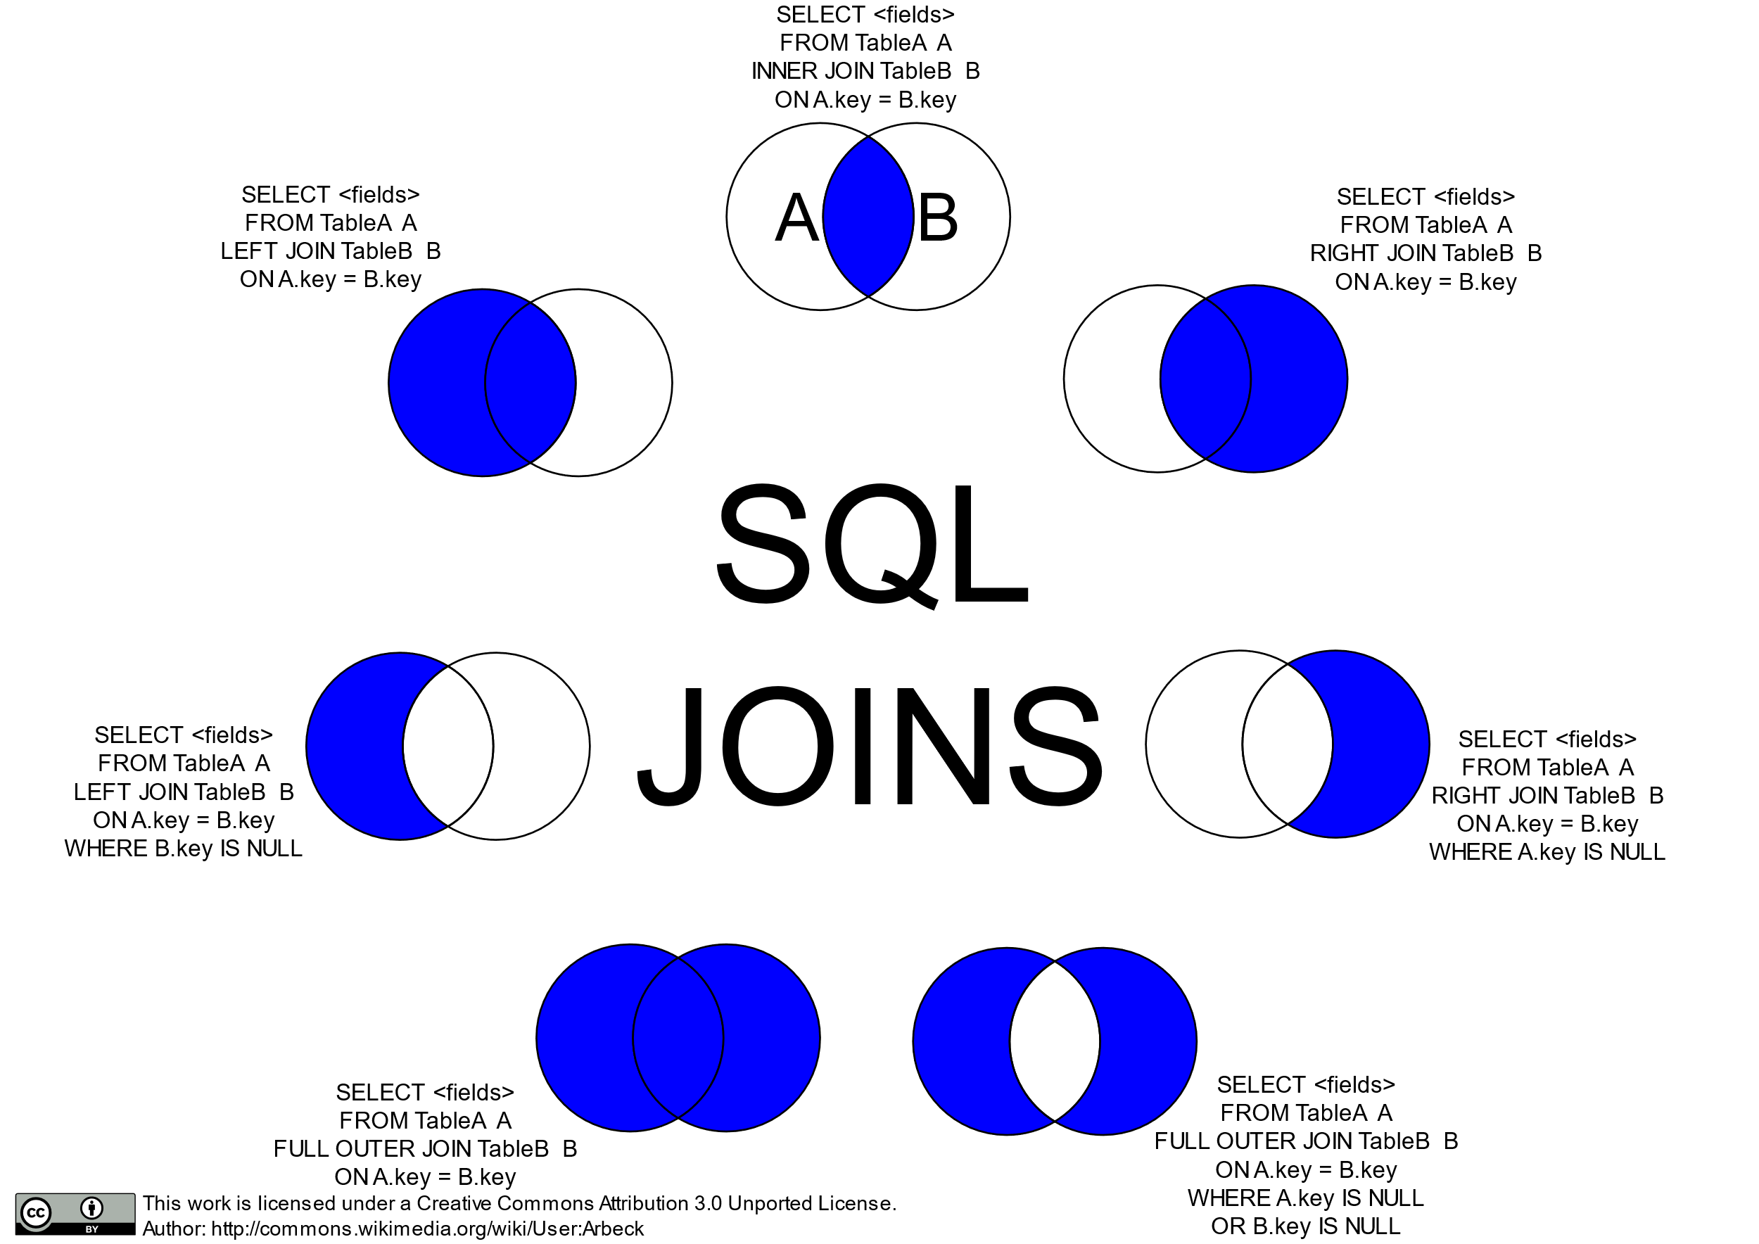

Slide 42
Left/Right Join

Slide 43
Inner/Outer Join

Slide 44
Anti-Joins

Slide 45
DB Connections

Slide 46



CONNECTING
‣
Database connectors require that your computer has the necessary software.
This will depend on what database type you are trying to connect to

Slide 47
ALLOWING HANDSHAKES
To setup database connections you will need to install the proper drivers.
The steps for this can be found here: https://db.rstudio.com/best-practices/drivers/
In general setup on Windows is a little bit easier since ODBC Data Source Administrator can be used
‣
‣
Your machine may already have drives installed if you’ve already installed SQL IDE’s such as: pgAdmin, DBeaver, or the MySQL Workbench

Slide 48

Storing Credentials

Slide 49
ENVIRONMENTAL VARIABLE OR FILE
You should never “hard code” your credentials into an app.
Instead you should store them as environmental variables, or in a hidden file that you ignore in the
Git Repository
If something requires that you to login, we can assume that not just anybody should be able to access it.
Think of your credentials like your debit card and pin number
Why?

Slide 50
BUILDING AN ENVIRON FILE
The usethis package has a function that will build your .Renviron file in your directory or for your entire profile.
How are .Renviron Files structured?
usethis::edit_r_environ()
usethis::edit_r_environ("project")
uid=some_username
pwd=Password
A new line for each variable
No spaces between variable name and value

Slide 51
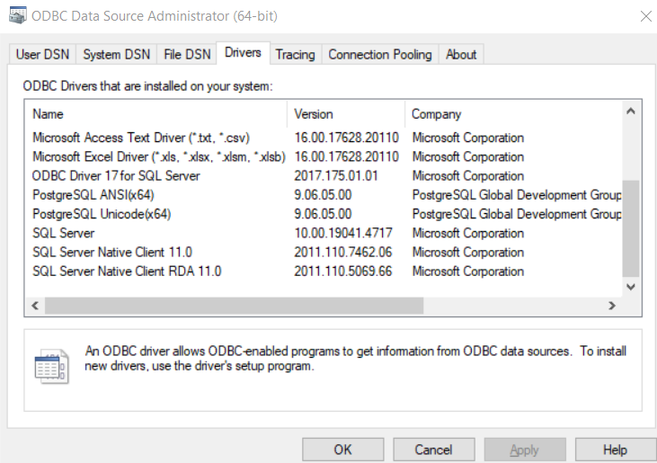
SQL Drivers
Checking Installed Drivers
Open ODBC Data Source Administrator (64-bit)
Ask DIT to install the one you need if it’s missing
Handles Max Length columns best
driver = “{ODBC Driver 17 for SQL Server}”
All 3 of these will also work

Slide 52
LOADING VARIABLES
Small difference between credentials in your profile or the project folder.
The string argument is the name you gave your variable
Profile .Renviron
Sys.getenv("uid")
Sys.getenv("pwd")
readRenviron(".Renviron")
Sys.getenv("uid")
Sys.getenv("pwd")

Slide 53
ESTABLISHING CONNECTIONS
Each data base type has a different connection string and list of requirements.
conn <- dbConnect(odbc::odbc(), driver = "{Driver Name}", server = "IP_or_HOST_ADDRESS", port = port#, database = "DBName", uid = un, pwd = pwd)
More on connection strings: https://db.rstudio.com/ best-practices/drivers/#connecting-to-a-database-in- r

Slide 54
Running a Query
If you want to load the whole table:
tbl <- dbReadTable(con, SQL("Schema.TableNameHere"))
If you want to run a custom query:
tbl <- dbReadTable(con, "Text of your SQL Query")

Slide 55
Your Turn
Go to Rstudio and open the dbi_example.Rmd and follow instructions and run the code chunks up to disconnect.

